Slide 1
UNDERWATER IMAGE ENHANCEMENT
Samudhrala Ishma
22

Slide 2
Underwater Image Degradation
Underwater images are significantly affected by light absorption and scattering, leading to color distortion, low contrast, and reduced visibility—especially in deeper or turbid water.
These degradations limit the effectiveness of critical tasks such as underwater object detection, marine ecosystem monitoring, and autonomous navigation.
Classical enhancement techniques (e.g., histogram equalization, white balancing, Retinex) are non-adaptive and often fail to generalize across varying underwater conditions.

Slide 3
Objective
To design a lightweight, U-Net-inspired convolutional neural network for underwater image enhancement, optimized for real-time deployment on low-power edge devices. The model adopts an encoder-decoder structure with skip connections, enabling it to preserve spatial details while enhancing visibility, color balance, and contrast. It is trained on a paired dataset using Mean Squared Error (MSE) loss to learn accurate pixel-level corrections.

Slide 4
Other Possible Methods
Traditional Image Processing
GAN based models
Transformer based models
Heavy CNNs

Slide 5
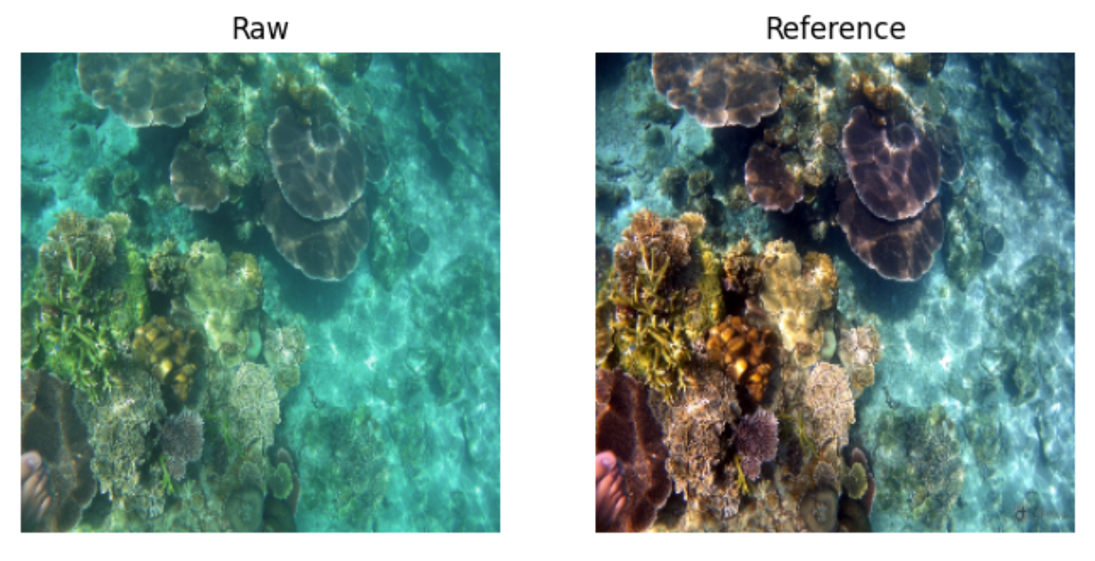
Dataset Used
UIEB: Underwater Image Enhancement Benchmark Dataset
It contains 890 real-world underwater images, each paired with a visually enhanced high-quality reference image created through manual selection by multiple human annotators.

Slide 6
Preprocessing
Image Resizing
Color Conversion (BGR to RGB)
Normalised
Tensor conversion

Slide 7
Model Architecture
Encoder:
4 convolutional blocks with:
Conv2D → ReLU → MaxPool
Feature extraction with increasing depth: 32 → 64 → 128 → 256
Decoder
4 upsampling blocks with:
Upsample → Concat(skip) → Conv2D → ReLU
Uses skip connections from encoder (like U-Net)
Final layer: 1×1 Conv → Sigmoid to reconstruct RGB image in range [0,1]

Slide 8
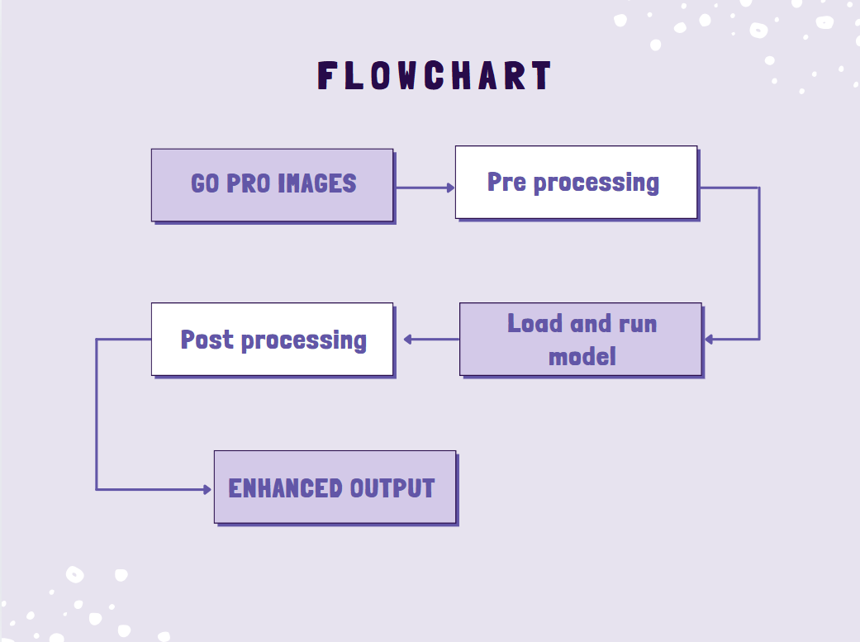

Slide 9
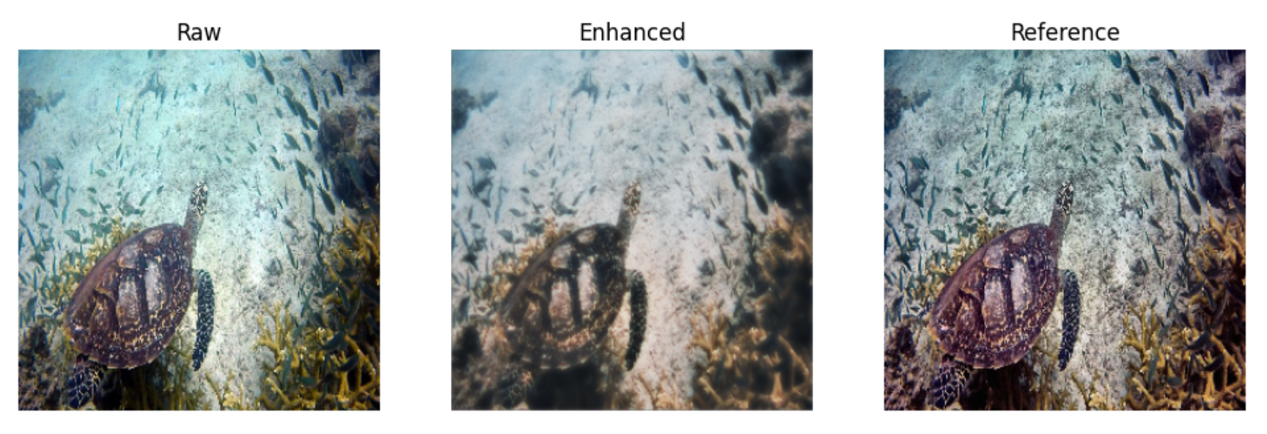
Validation Results

Slide 10
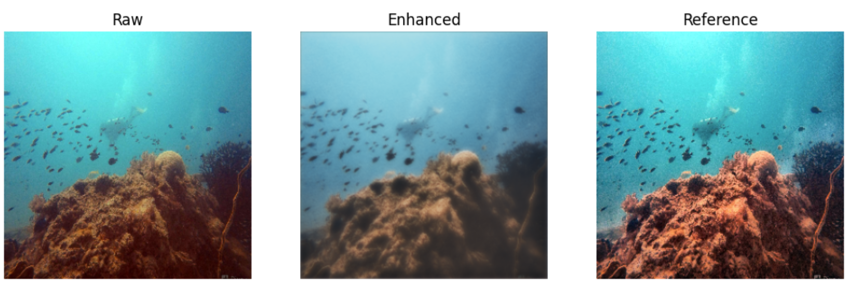
Validation Results

Slide 11
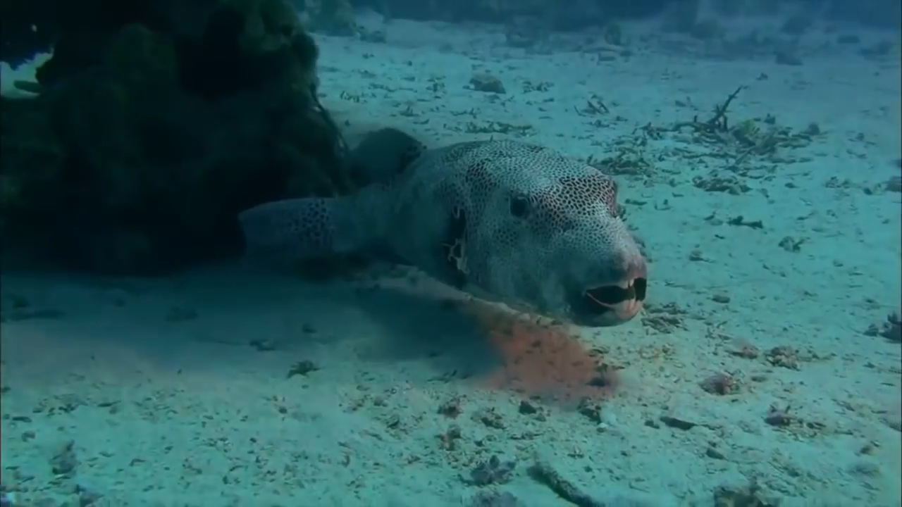
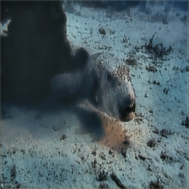
Test Results
Input Image
Output Image

Slide 12
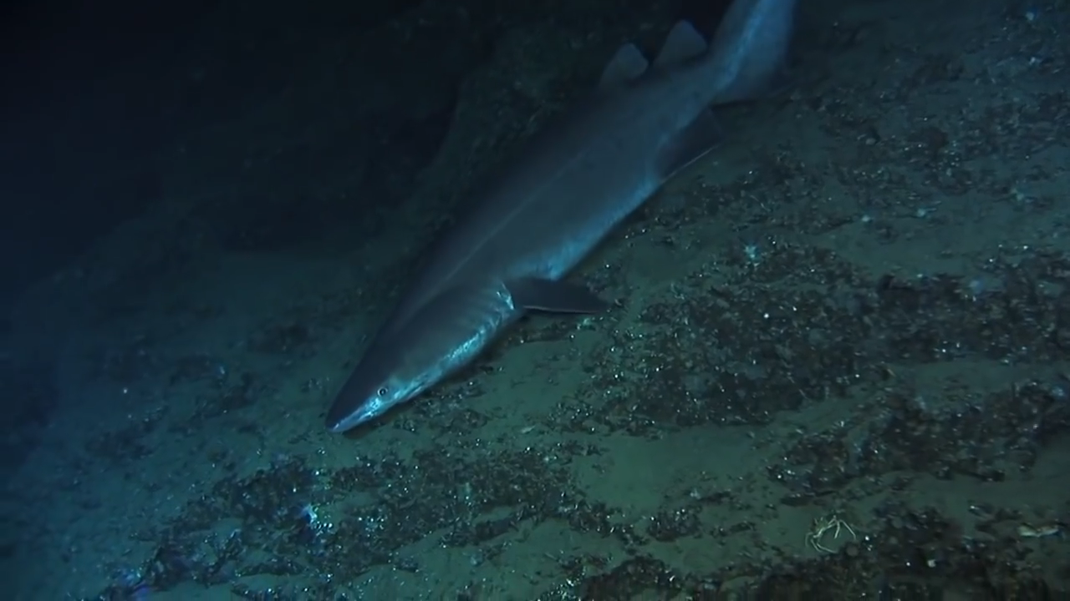
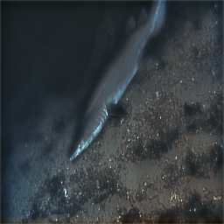
Test Results
Input Image
Output Image

Slide 13
Future Scope
The goal is to move beyond still-image enhancement and support real-time enhancement for live rescue operations using:
ROVs (Remotely Operated Vehicles)
Diver-mounted cameras
Search drones equipped with underwater cameras
This enables rescuers to make faster, more accurate decisions during critical operations

Slide 14
References
[1] C. Li, S. Anwar, and C. Li, “UIEB Dataset and Its Application in Underwater Image Enhancement,” *IEEE Trans. Image Process.*, vol. 33, no. 9, pp. 3452–3463, Sep. 2024.
[2] K. Liu and C. Zhou, “LU2Net: Lightweight U-Net for High-Speed Underwater Image and Video Enhancement,” *IEEE J. Ocean. Eng.*, vol. 49, no. 1, pp. 78–89, Jan. 2024.
[3] Z. Li, B. Xu, X. Wang, W. Song, and H. Wang, “Zero-Reference Underwater Adaptive Enhancement Network (Zero-UAE),” *IEEE Trans. Circuits Syst. Video Technol.*, vol. 34, no. 2, pp. 1234–1245, Feb. 2024.
[2] J. Kim, M. Park, and H. Lee, “LiteEnhanceNet: A Lightweight Network for Real-Time Single Underwater Image Enhancement,” *Expert Syst. Appl.*, vol. 240, p. 122546, 2024.
[5] D. Priyadarshni and M. K. H. Kolekar, "Underwater object detection and tracking," in *Soft Computing: Theories and Applications: Proceedings of SoCTA 2018*, Singapore: Springer, pp. 837–846, 2020.
[6] H. Wang, Y. Sun, and L. Zhao, “FA⁺Net: A Five-Branch Attention Network for Ultra-Lightweight Real-Time Underwater Image Enhancement,” in *Proc. IEEE Int. Conf. Image Process. (ICIP)*, 2023, pp. 456–460.

Slide 15
THANK YOU

